Slide 1
Introduction to the course: Verifying cyberphysical systems
Verifying cyberphysical systems
August 23th 2021, ECEB 2013
Sayan Mitra
CSL 266
mitras@illinois.edu
@Mitrasayn

Slide 2
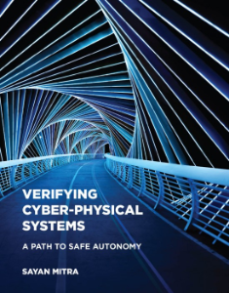
Welcome to Fall 21 edition of ECE/CS 584!

Slide 3
Introduction
What is this class about?

Slide 4
What is verification?
Definition. Verification is the action of demonstrating or proving some statement to be true by means of evidence. OED
This class:
some statement = about cyber-physical systems
evidence = mathematical proof

Slide 5
What are cyber-physical systems (CPS)?
A computer system monitoring or controlling a physical process.
Examples: a drone for package delivery, control system for a smart electric grid, insulin pump for blood glucose control, …
The number of possible behaviors of such systems is usually uncountably infinite
Requirements: Statements about all behaviors
Drone visits waypoints while avoiding collisions
Under all nominal conditions the vehicle stays within the lanes
Insulin pump maintains blood glucose level to within the prescribed range
Testing: evaluates requirements on a finite number of behaviors
Verification: aims to prove requirements over all behaviors

Slide 6
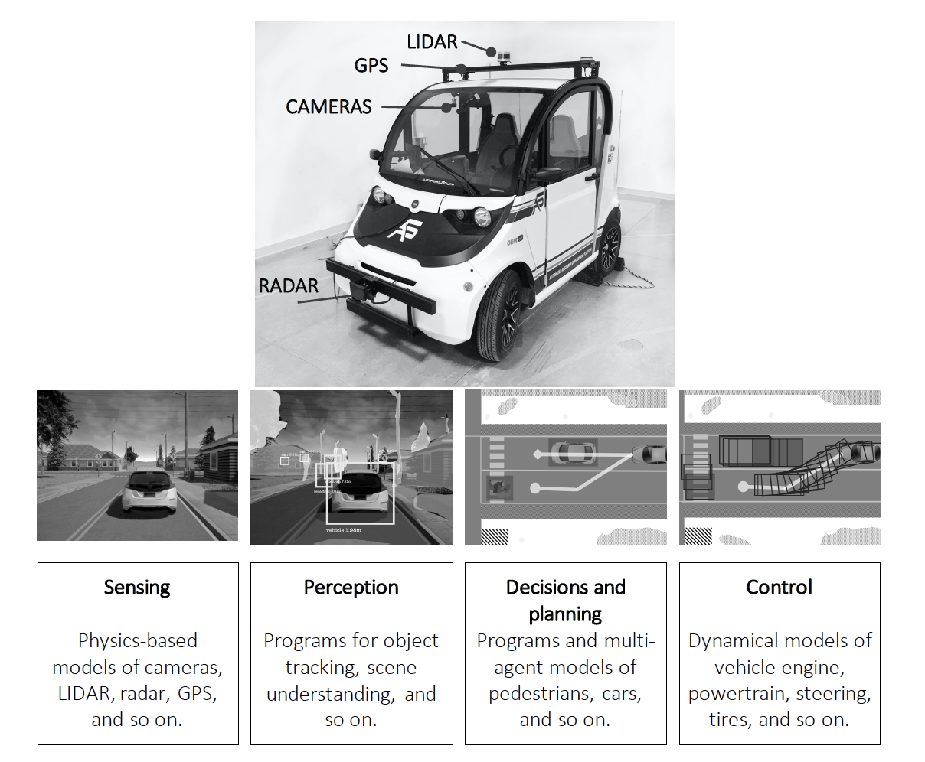
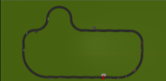
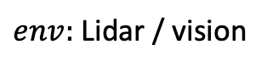
Autonomous vehicle: An example CPS
Perception
Planning and decision
Control
Vehicle dynamics
Sensing
Environment
$env:$ Lidar / vision

Slide 7
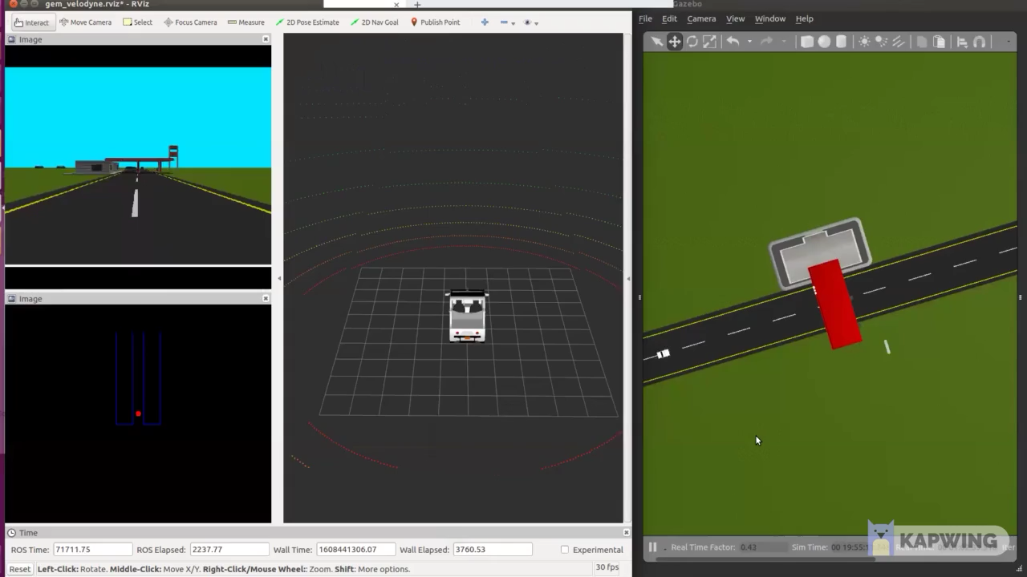
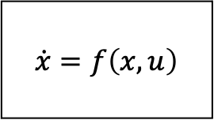
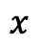
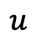
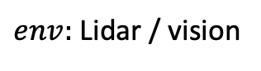
Open problem
Simulated race car following a track with Lidar-based perception and control.
Problem: For a given track and initial conditions check that the trajectory of the car does not collide and stays in lane.
Can we check efficiently?
Can we generalize to similar tracks?
What should we assume about perception, accuracy of the vehicle model?
What should we assume about the execution of the controller?
Perception
Controller program
$$\dot{x}=f\left(x, u\right)$$
$$u$$
Environment
/ Track
$env:$ Lidar / vision
$$x$$

Slide 8
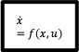
The verification problem
System Model/Code & Property
Algorithm
or Method
Bug trace
8
Proof or Certificate
Perception
Controller program
$$u$$
$$\dot{x}=f\left(x, u\right)$$
Environment
/ Track
$$x$$
Verification. The action of demonstrating or proving to be true by means of evidence; formal assertion of truth. (OED)
Notes:
Most important topic you have never heard of.

Slide 9
Program verification
System. A subroutine sort(int a[])
for returning a sorted array of integers in some programming language, e.g. C
counterexample. A particular input array a and initialization of sort that produces wrong output
A model M for execution of programs in C
System Model/Code & Property
Algorithm
or Method
Bug trace
Requirement. Output of sort(int a[])
is the sorted version of the input array a[]
Certificate
A mathematical proof that establishes that sort(int a[])works for all inputs in the given model M of C
Verifying compiler. Checks that sort meets the requirement

Slide 10
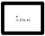
A cyber-physical example
System. A program/system for lane keeping control for vehicles
counterexample. A particular environment situation (lane geometry, sensor failure, computer configuration) that makes the vehicle go outside lanes
Model/assumptions for executing such programs including the effects on the physical vehicle
System Model/Code & Property
Algorithm
or Method
Bug trace
Requirement. The vehicle does not go outside the lane boundaries
Perception
Controller program
$$u$$
$$\dot{x}=f\left(x, u\right)$$
Proof Certificate
A mathematical proof that establishes that for all allowed inputs and environments the vehicle stays with the lane
Environment
/ Track
$$x$$
Verification tool
When can we build such a tool? How expensive is it? How well is it going to work? Under what assumptions?

Slide 11
Our goals in this course
Algorithm
or Method
Write programs (tools) that prove correctness
Understand fundamental limits of creating such tools
Learn models of CPS at different levels of abstractions
Gain research experience

Slide 12
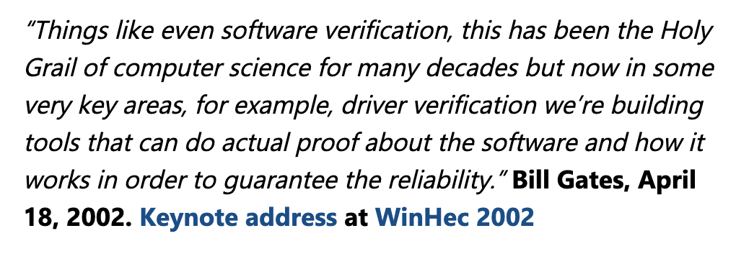
Successes of Verification
Hardware verification now standard in EDA tools from Synopsys, Cadence, etc.
SLAM tool from MSR routinely used for verification of Device Drivers at Microsoft:
AMAZON AWS developers write proofs using CBMC and other Automated reasoning tools
Goolge runs static analysis tools on their entire codebase
Formal modeling and analysis is becoming part of certification process for avionics (e.g., ASTREE); DO-333 supplement of DO-178C identifies aspects of airworthiness certification that pertains to of software using formal methods
Coverity, Galois, SRI, and others
Automotive and manufacturing ... coming soon.

Slide 13
Intellectual successes
Turing Awards: Lamport (2014), Clarke, Sifakis & Emerson (2008), Pnueli (1997), Lampson (1992), Milner (1991), Hoare (1980), Dijkstra (1972) …
ACM Doctoral Dissertation Award: Chuchu Fan (2020) alumni of this class
Covers and connects some of the brightest ideas in CS and control
Vibrant community: CAV, TACAS, PLDI (programming languages),
HSCC, EMSoft, ICCPS (hybrid and cyber-physical systems)
Robotics, automatic control
AI and machine learning
Faculty and research positions: Alumni of this course are professors at Vanderbilt, UNC Chapel Hill, MIT, Kansas, Stoney Brook, and researchers at Waymo, Toyota, Boeing

Slide 14
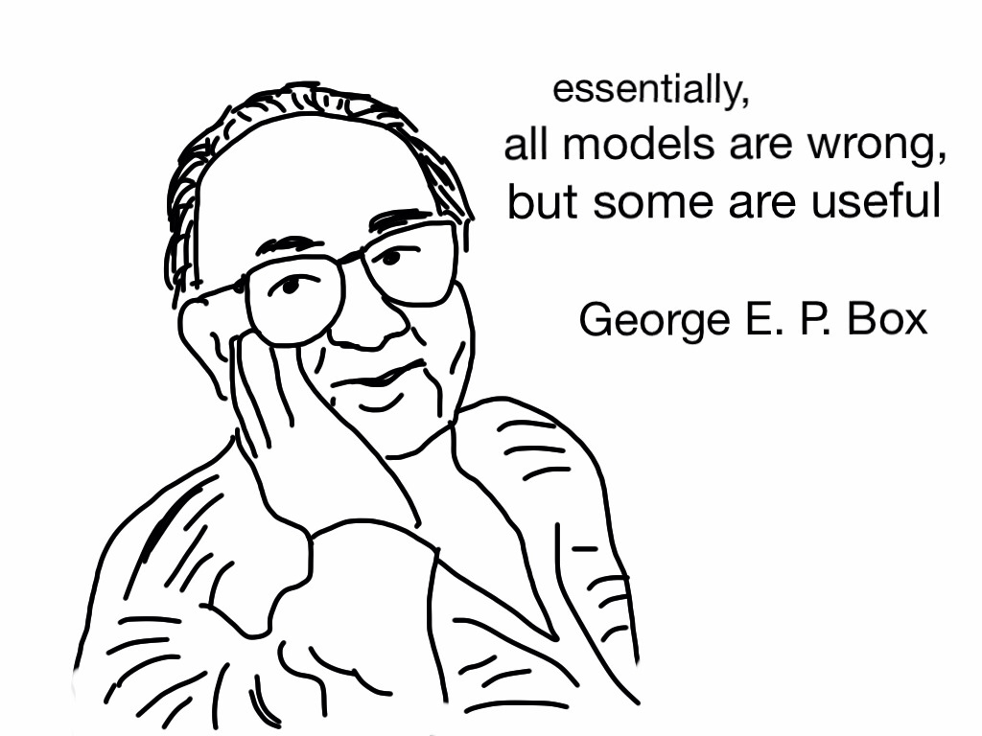
Challenge 1: Models
To prove anything, first we have to start with assumptions
Assumptions are captured in the models (of cyberphysical systems)
1/3 of this class is about models
Programs, state machines, or differential equations, block diagrams
Discrete or continuous time, state or both -- hybrid
Deterministic or nondeterministic or probabilistic
Composition and interfaces, abstraction
Modeling languages, tools
https://tribalsimplicity.com/2014/07/28/george-box-models-wrong-useful/

Slide 15
Challenge 2: Scalability
Verification of hybrid automaton is undecidable
No one can find the is Algorithm of that type
Approximate and bounded time versions of the problem can be solved algorithmically
Often the algorithms do not scale with the size of the model, number of agents, time horizon, etc.
System Model/Code & Property
Algorithm
or Method
Bug trace
Certificate
Trilemma: Scalability of analysis vs Expressivity of model vs Precision of analysis
Notes:
Data scientist log(n), algorithmist O(Poly(n)), verification engineer O(PSPACE(n))
buzzkills, hype-kills

Slide 16
Perspectives on scalability
Solution does not scale
This is perfect!
Yay, decidable!
O(n)
O(n)
O(2^{n})
data scientist
algorithmist
verification engineer
Notes:
Roshomon

Slide 17
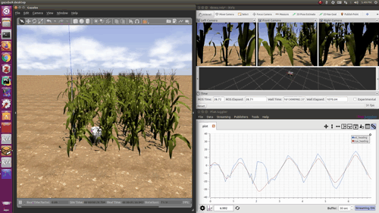
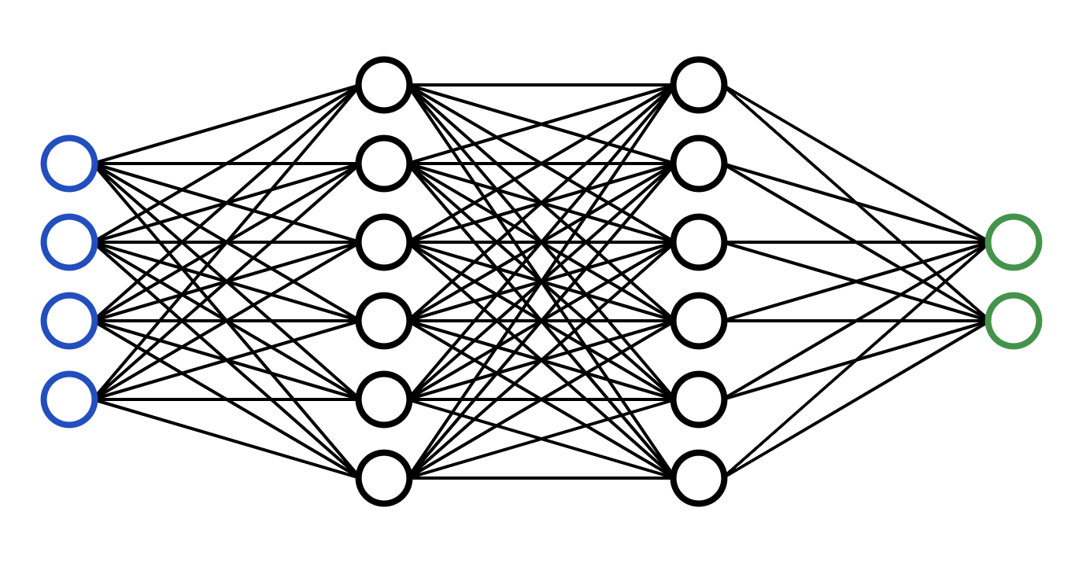
Challenge 3: Perception
New, underspecified, empirical
Well-understood
def control(heading, dist):
error = heading + arctan(KP*dist, VEL)
# Calculate controller output
ang_vel = error / CYCLE_TIME
if ang_vel > VEL_MAX:
ang_vel = VEL_MAX
elif ang_vel < VEL_MIN:
ang_vel = VEL_MIN
return ang_vel
Perceived variables
heading, dist
Nnet-based Lane detection
Lateral
controller
image
Controlled variables
angular velocity
Environment
simulated
Vehicle model
Uncontrolled variables
lighting, weather, etc.

Slide 18
Learning objectives
Invariant, barrier certificates, ranking functions, stability, self-stabilization, convergence, transition system
Foundational connections between computer science and control theory
Model anything
Introduction to key concepts in formal methods and cyberphysical systems; exposure to some of the most influential ideas in CS and control theory
Learn powerful algorithms and tools
Jumpstart research
Programs, state machines, or differential equations, discrete or continuous state or both, Hybrid, switched, Deterministic or nondeterministic or both, composition, interfaces, abstraction, modeling languages, tools
satisfiability modulo theory, semantics, temporal logics, theorem provers, SAF solvers, ranking functions, data-driven verification, HYLAA, C2E2, SpaceEx, Flow*, Z3, …
semester-long project, feedback, presentation, hardware, software, and data resources

Slide 19
Administrivia
How the course works

Slide 20
Illinois 2021 Edition
https://wiki.illinois.edu/wiki/pages/viewpage.action?pageId=642598908
Lectures TR 12:30 – 1:50
Textbook
Homeworks: 4-5 sets. Analysis and some coding
Project: Semester long research project, usually leads to a publication

